Slide 1
FRETTING WEAR
GAURAV SETH
ME II YEAR
08996

Slide 2
CONTENTS
Introduction to wear
Definition of fretting wear
Mechanism and modes
Factors affecting fretting wear
Prevention and control
References

Slide 3
WEAR
Removal of material from one or both surfaces in relative motion
It is a system response
Can be desirable or undesirable
High friction doesn’t always mean high wear
Notes:
Read from williams

Slide 4
WEAR MECHANISMS
Adhesive wear
Abrasive wear
Corrosive wear
Fatigue wear

Slide 5
WEAR PROCESS
Particle detachment
Third body formation
Particle ejection

Slide 6
FRETTING WEAR
Fretting – Small amplitude (~ a few microns) oscillatory motion, normally tangential.
Loss of material as debris arising due to fretting is called as fretting wear.
The wear debris produced are often retained within the contact due to small amplitude sliding.

Slide 7
…CONTD.
Accumulated wear debris accelerates the wear process by abrasion.
Significant localised damage.
Leads to loss of clearance in many applications.
Can also cause jamming when the debris is
strongly held in the contact.

Slide 8
…CONTD.
Found in all contacts subject to vibration.
Encountered in all quasi-static loaded assemblies such as splines , keys, bearing races, shafts, orthopaedic implants, turbine blade roots, nuclear reactor components, power plant machinery, etc.

Slide 9
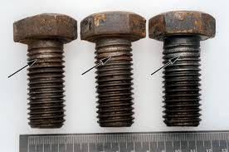
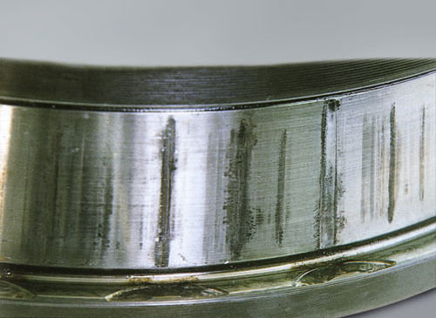
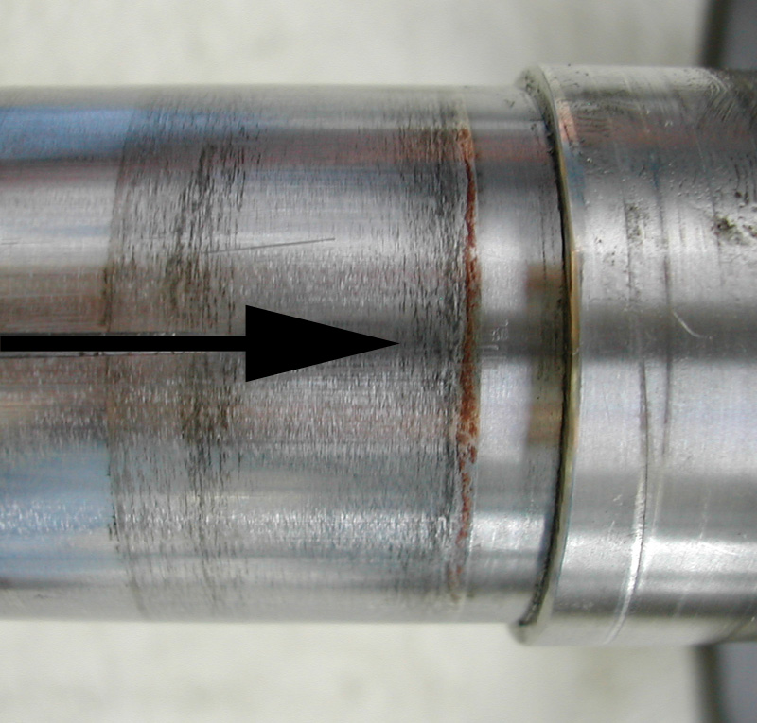
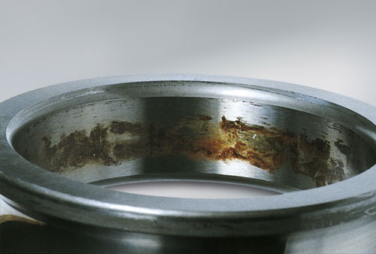

Slide 10
RELATED TERMS
Fretting fatigue
Fretting corrosion

Slide 11
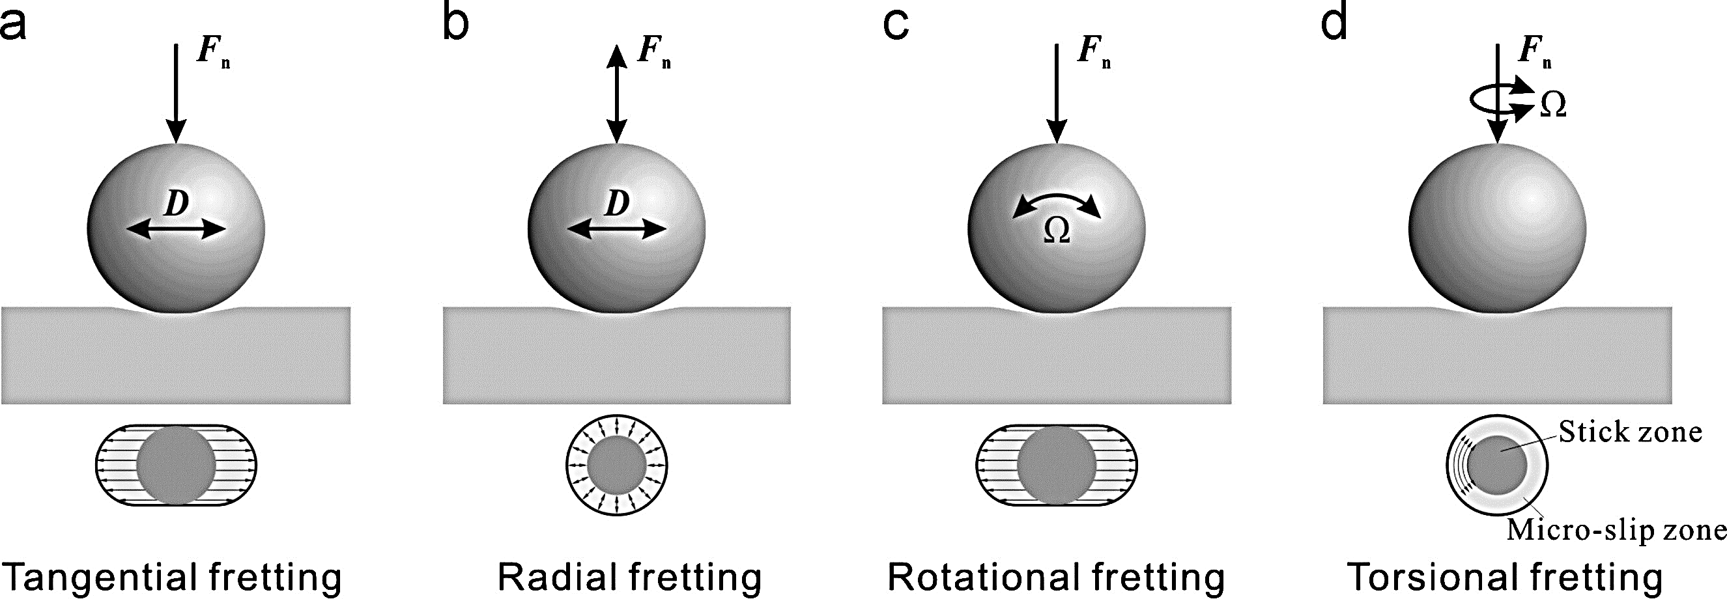
MODES OF FRETTING WEAR

Slide 12
MECHANISM

Slide 13
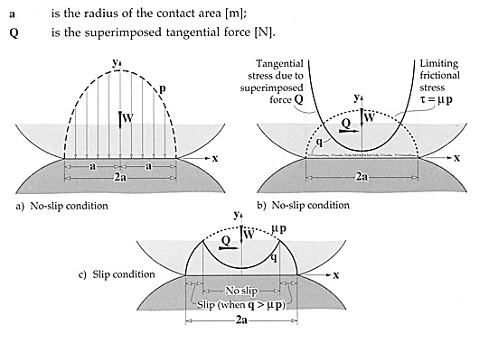
ELASTIC MODEL

Slide 14
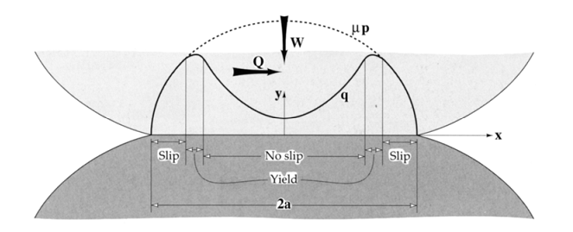
ELASTO-PLASTIC MODEL

Slide 15
FACTORS AFFECTING
More than 50 parameters play a part!!!
Most of them are interdependent (thankfully)
The important factors are :-
(a) Amplitude
(b) No. of cycles
(c) Frequency
(d) Material
(e) Contact temperature
(f) Stress field
(g) Environment

Slide 16
HOW TO DETECT
For unaided eye :-
(a) Corroded stained surfaces where damage on one surface is mirror image of mating surface
(b) Loose, coloured debris around real contact areas
(c) Rouge coloured films, debris, grease or oil for steel
Microscopically :- Thick films of oxide and metal. Red and black for steel
Oil Analysis :- Identify metal oxide (ferric oxide for steel) by X-ray diffraction

Slide 17
PREVENTION
Reduce or stop vibration by tighter fit or higher load
Improve lubrication
Use oil of lower viscosity
Relubricate frequently
Use oxidation inhibitors in oil

Slide 18
…CONTD.
Local heat treatment (thermal hardening)
Disadvantage – substrate needs to be heated to high temperatures
Adding an alloying element (carburizing, nitriding, carbo nitriding, etc.
Use wear resistant coatings. Fretting wear can be mitigated by hard coatings, e.g. , carbides, at small fretting amplitudes. Prevailing wear mechanism needs to be recognized for coating optimization.

Slide 19
REFERENCES
Williams, J. A. (1994), Engineering Tribology, Oxford University Press, New York
Stachowiak G.W. and Batchelor A.W. (2005), Engineering Tribology, 3rd ed., Elsevier, Oxford, UK
Berthier Y., Vincent L. and Godet M. (1989), Fretting Fatigue and Fretting Wear
www.google.com
www.wikipedia.com

Slide 20
THANK YOU
THANK YOU
THANK YOU

